Slide 1
Training GNU compiler and GNU make
FSU11-BU2
Create: QuangCM1

Slide 2
Content
GNU compiler (gcc)
GNU make (make and Makefile)

Slide 3
1.GNU compiler
Overview
How to compile
GCC Compilation Process
Static vs Shared Libraries
Searching header and library

Slide 4
1.1. Overview
Original GCC is GNU C Compiler
Now it means GNU Compiler Collection (C, C++, Java, Fortran …)
Compile from source code to executable file
Example
Command | output | execute
gcc hello.c | a.out | ./a.out
gcc –o hello hello.c | hello | ./hello

Slide 5
1.2. How to compile
Build simple program (default output is a.out, we can specify output by –o option)
# gcc test.c
# gcc –o test test.c
Only compile to object then link object to executable file
# gcc –c test.c (no need specify test.o)
# gcc –o test test.o
= # gcc –o test test.c

Slide 6
1.2. How to compile
Build multiple files
# gcc –o test test1.c test2.c test3.c
Build multiple files
# gcc –c test1.c
# gcc –c test2.c
# gcc –c test3.c
# gcc –o test test1.o test2.o test3.o

Slide 7
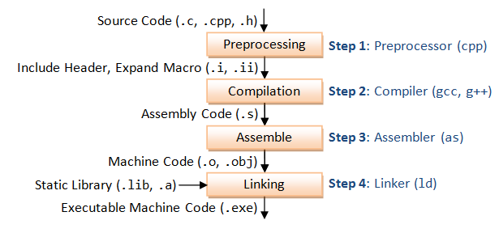
1.3. GCC Compilation Process
GCC compile C/C++ source code to executable file in 4 steps

Slide 8
1.3. GCC Compilation Process
For example, a “gcc -o hello.exe hello.c” is carried out as follow:
  Step1 - Preprocessing by GNU C preprosessor (cpp), which include headers (#include) and macros (#define)
  # cpp hello.c > hello.i
  File hello.i contains the expanded source code

Slide 9
1.3. GCC Compilation Process
  Step2 - Compilation: the compiler compiles the preprocessed source code into assembly code for a specific processor
  # gcc –S hello.i
  The -S option specifies to produce assembly code, instead of object code. The resultant assembly file is "hello.s"

Slide 10
1.3. GCC Compilation Process
  Step3 - Assembly: the assembler (as.exe) converts the assembly code into machine code in the object file "hello.o".
  # as -o hello.o hello.s
  Step4 - Link: finally, the linker (ld.exe) links the object code with the library code to produce an executable file "hello.exe"
  # ld -o hello.exe hello.o <libraries>

Slide 11
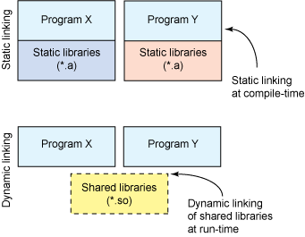
1.4. Static vs Shared Libraries
Static library: *.a (archive file)
Shared library: *.so (shared object)

Slide 12
1.5. Searching header, library
Header: -I
Library: -L and –l
Example:
# gcc –o test test.c –I/test/inc –L/test/lib –lxxx
The example above means:
  Include directory is /test/inc
  Library directory is /test/lib
  The specific library is libxxx.a (or libxxx.so)

Slide 13
2. GNU make
Overview
Makefile

Slide 14
2.1. Overview
make is an command to build source code automatically
make will find instruction in a file (makefile)
The instruction file is “Makefile” or “makefile” or specified by –f option.
# make
or
# make –f MyMakeFile

Slide 15
2.2. Makefile
Basic syntax of Makefile
Simple Makefile
Phony target
Implicit rules
Macro and special characters

Slide 16
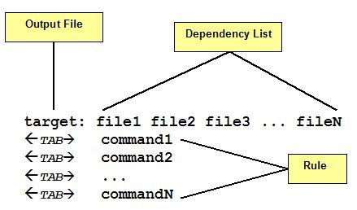
Basic syntax of Makefile
A Makefile consists a set of targets, dependencies and rules

Slide 17

Simple Makefile
Example
test: main.o test1.o
gcc -o test main.o test1.o
main.o: main.c test.h
gcc -c main.c -I.
test1.o: test1.c test.h
gcc -c test1.c -I.
clean:
rm -f test *.o

Slide 18
Phony target
Generally, a target means an output file.
Sometimes, a target does not means a file but it might represent an action/command.
When a target is not related a file it is called phony target.
Specifed by keyword .PHONY

Slide 19
Implicit rules
By default, make already known an object xxx.o must be made from a source xxx.c => so, let the make deduce the commands
List all the rule via --print-data-base option
CC=gcc
FLAGS=-I.
test: main.o test1.o
$(CC) -o test main.o test1.o
main.o: main.c test.h
$(CC) -c main.c $(FLAGS)
test1.o: test1.c test.h
$(CC) -c test1.c $(FLAGS)
clean:
rm -f test *.o
CC=gcc
FLAGS=-I.
test: main.o test1.o
$(CC) -o test main.o test1.o
clean:
rm -f test *.o

Slide 20
Macro
Similar to variable
MACRONAME=value
Access value $(MACRONAME) or ${MACRONAME}
CC=gcc
FLAGS=-I.
test: main.o test1.o
$(CC) -o test main.o test1.o
main.o: main.c test.h
$(CC) -c main.c $(FLAGS)
test1.o: test1.c test.h
$(CC) -c test1.c $(FLAGS)
clean:
rm -f test *.o

Slide 21
Special characters
$@: the target filename
$^: the filenames of all the prerequisites, separated by spaces, discard duplicates
CC=gcc
FLAGS=-I.
test: main.o test1.o
$(CC) -o $@ $^
clean:
rm -f test *.o

Slide 22
Special characters
$*: the target filename without extension
$<: the first prerequisite filename
$+: similar to $^, but includes duplicates
$?: the names of all prerequisites that are newer than the target, separated by spaces

Slide 23
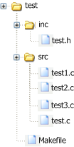
Exercise
Tạo 1 project có cấu trúc như sau. 3 file test1.c, test2.c, test3.c mỗi file implement 1 hàm test1, test2, test3, file test.c gọi 3 hàm đấy. Viết makefile để build project tạo ra file executable tên là test.

Slide 24
Reference
http://www.ibm.com/developerworks/linux/library/l-dynamic-libraries/index.html
http://www3.ntu.edu.sg/home/ehchua/programming/cpp/gcc_make.html
http://www.gnu.org/software/make/manual/html_node/index.html
http://www.embeddedheaven.com/linux-makefile-tutorial.htm
http://www.chemie.fu-berlin.de/chemnet/use/info/make/make_toc.html

